Slide 1
Boolean Model
Hongning Wang
CS@UVa

Slide 2
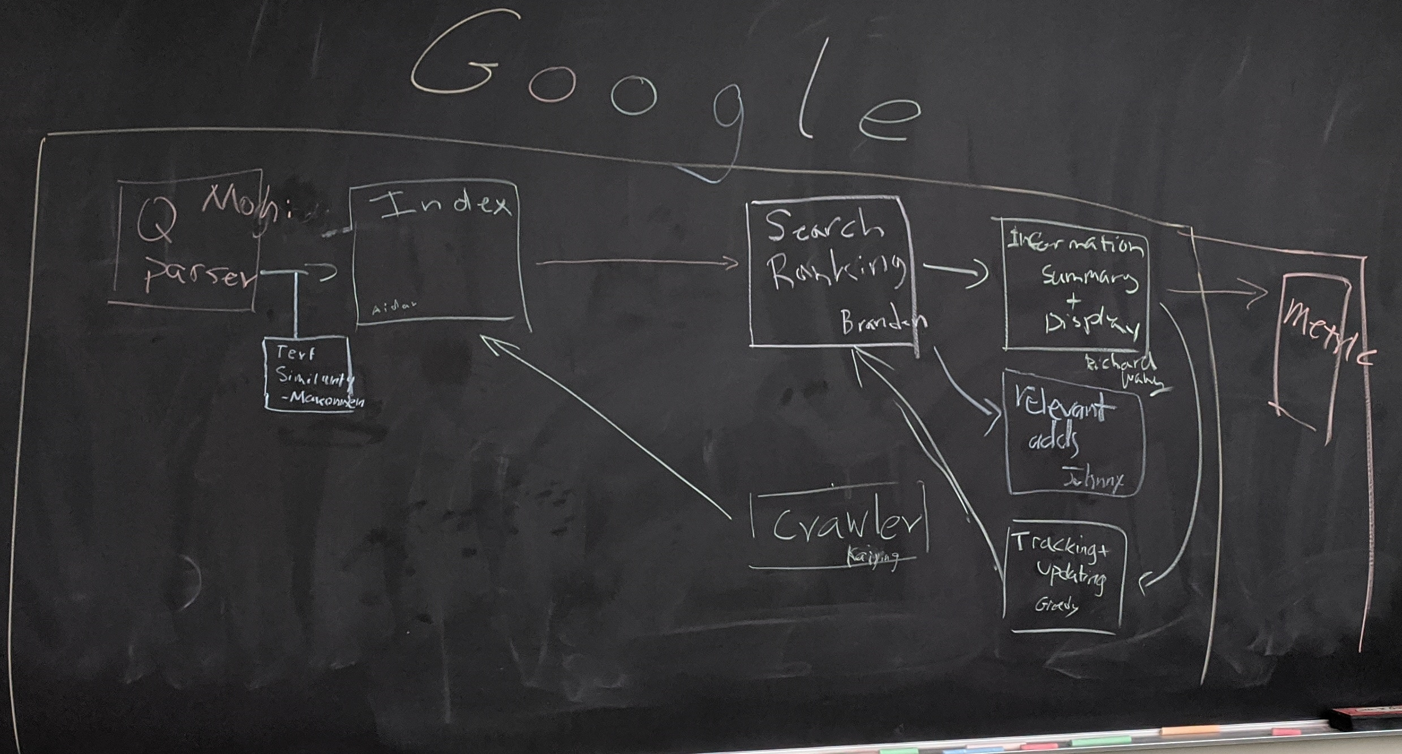
Abstraction of search engine architecture
Indexed corpus
Crawler
Ranking procedure
Feedback
Evaluation
Doc Analyzer
(Query)
Query Rep
User
Doc Representation
Ranker
Indexer
results
Index

Slide 3
Search with Boolean query
Boolean query
E.g., “obama” AND “healthcare” NOT “news”
Procedures
Lookup query term in the dictionary
Retrieve the posting lists
Operation
AND: intersect the posting lists
OR: union the posting list
NOT: diff the posting list

Slide 4
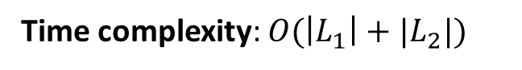
Search with Boolean query
Example: AND operation
scan the postings
Term1
2
4
8
16
32
64
128
Term2
1
2
3
5
8
13
21
34
Time complexity: $O(\left|L_{1}\right|+|L_{2}|)$
Trick for speed-up: when performing multi-way join, starts from lowest frequency term to highest frequency ones

Slide 5
Deficiency of Boolean model
The query is unlikely precise
“Over-constrained” query (terms are too specific): no relevant documents can be found
“Under-constrained” query (terms are too general): over delivery
It is hard to find the right position between these two extremes (hard for users to specify constraints)
Even if it is accurate
Not all users would like to use such queries
Not all relevant documents are equally important
No one would go through all the matched results
Relevance is a matter of degree!

Slide 6
Document Filtering vs. Ranking
+
-
+
-
Rel’(q)
1
+
True Rel(q)
Doc Filtering
f(d,q)=?
+
+
-
-
-
+
-
-
-
-
-
+
-
+
-
0
-
+
-
+
-
-
+
-
-
-
-
-
-
-
-
-
-
Doc Ranking
rel(d,q)=?
0.98 d₁ +
0.95 d₂ +
0.83 d₃ -
0.80 d₄ +
0.76 d₅ -
0.56 d₆ -
0.34 d₇ -
0.21 d₈ +
0.21 d₉ -
-
Rel’(q)

Slide 7
Ranking is often preferred
Relevance is a matter of degree
Easier for users to find appropriate queries
A user can stop browsing anywhere, so the boundary is controlled by the user
Users prefer coverage would view more items
Users prefer precision would view only a few
Theoretical justification: Probability Ranking Principle

Slide 8
Retrieval procedure in modern IR
Boolean model provides all the ranking candidates
Locate documents satisfying Boolean condition
E.g., “obama healthcare” -> “obama” OR “healthcare”
Rank candidates by relevance
Important: the notion of relevance
Efficiency consideration
Top-k retrieval (Google)

Slide 9
Notion of relevance
Relevance
Δ(Rep(q), Rep(d))
Similarity
P(r=1|q,d) r ∈{0,1}
Probability of Relevance
P(d →q) or P(q →d)
Probabilistic inference
Regression
Model
(Fox 83)
Generative Model
Different inference system
Different
rep & similarity
Doc
generation
Query
generation
…
Prob. concept
space model
(Wong & Yao, 95)
Inference
network
model
(Turtle & Croft, 91)
Vector space
model
(Salton et al., 75)
Prob. distr.
model
(Wong & Yao, 89)
Classical
prob. Model
(Robertson &
Sparck Jones, 76)
LM
approach
(Ponte & Croft, 98)
(Lafferty & Zhai, 01a)
Today’s lecture

Slide 10
Intuitive understanding of relevance
Fill in magic numbers to describe the relation between documents and words
 | information | retrieval | retrieved | is | helpful | for | you | everyone
Doc1 | 1 | 1 | 0 | 1 | 1 | 1 | 0 | 1
Doc2 | 1 | 0 | 1 | 1 | 1 | 1 | 1 | 0
Query | 1 | 1 | 0 | 0 | 0 | 0 | 0 | 0
E.g., 0/1 for Boolean models, probabilities for probabilistic models

Slide 11
Some notations
Vocabulary V={w₁, w₂, …, w_{N}} of language
Query q = t₁,…,t_{m}, where t_{i} ∈ V
Document d_{i} = t_{i1},…,t_{in}, where t_{ij} ∈ V
Collection C= {d₁, …, d_{k}}
Rel(q,d): relevance of doc d to query q
Rep(d): representation of document d
Rep(q): representation of query q

Slide 12
Vector Space Model
Hongning Wang
CS@UVa

Slide 13
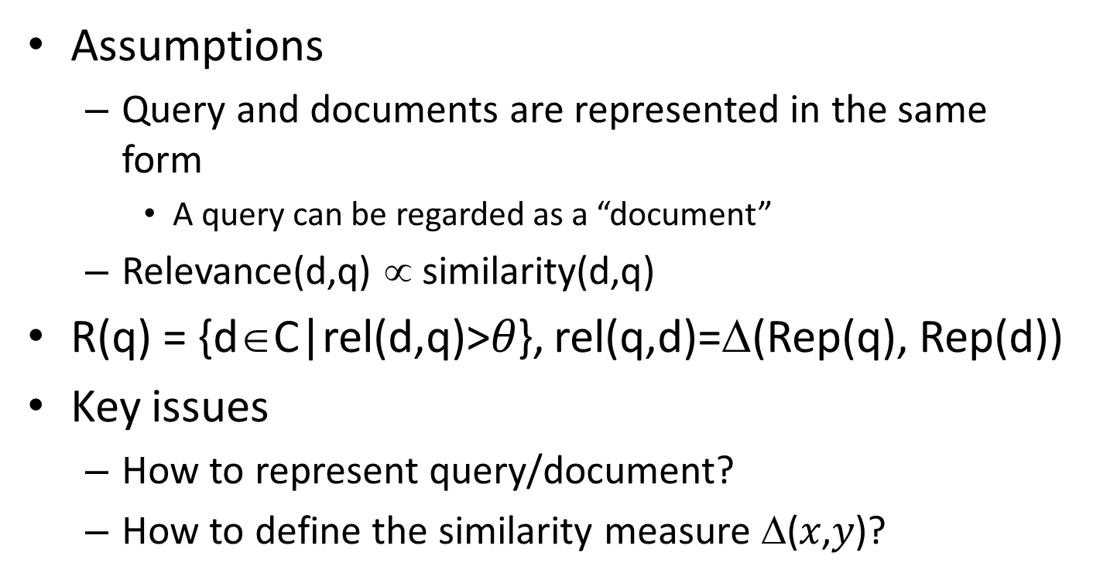
Relevance = Similarity
Assumptions
Query and documents are represented in the same form
A query can be regarded as a “document”
Relevance(d,q) ∝ similarity(d,q)
R(q) = {d∈C|rel(d,q)>$θ$}, rel(q,d)=Δ(Rep(q), Rep(d))
Key issues
How to represent query/document?
How to define the similarity measure Δ($x$,$y$)?

Slide 14
Vector space model
Represent both document and query by concept vectors
Each concept defines one dimension
K concepts define a high-dimensional space
Element of vector corresponds to concept weight
E.g., d=(x₁,…,x_{k}), x_{i} is “importance” of concept i
Measure relevance
Distance between the query vector and document vector in this concept space

Slide 15
VS Model: an illustration
Which document is closer to the query?
Finance
D₂
D₄
D₃
Sports
Query
D₅
D₁
Education

Slide 16
What the VS model doesn’t say
How to define/select the “basic concept”
Concepts are assumed to be orthogonal
How to assign weights
Weight in query indicates importance of the concept to the user’s information need
Weight in doc indicates how well the concept characterizes the doc
How to define the similarity/distance measure

Slide 17
What is a good “basic concept”?
Orthogonal
Linearly independent basis vectors
“Non-overlapping” in meaning
No ambiguity
Weights can be assigned automatically and accurately
Existing solutions
Terms or N-grams, i.e., bag-of-words
Topics, i.e., topic model

Slide 18
How to assign weights?
Important!
Why?
Query side: not all terms are equally important
Document side: some terms carry more information about the content
How?
Two basic heuristics
TF (Term Frequency) = Within-doc-frequency
IDF (Inverse Document Frequency)

Slide 19
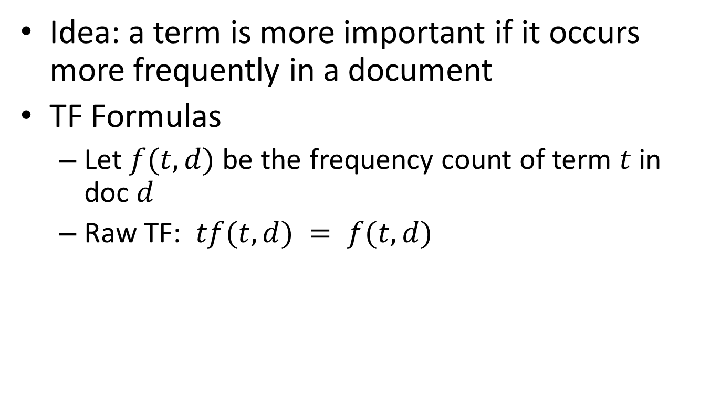
TF weighting
Idea: a term is more important if it occurs more frequently in a document
TF Formulas
Let $f(t,d)$ be the frequency count of term $t$ in doc $d$
Raw TF: $tf(t,d) = f(t,d)$

Slide 20
TF normalization
Query: iphone 6s
D1: iPhone 6s receives pre-orders on September 12.
D2: iPhone 6 has three color options.
D3: iPhone 6 has three color options. iPhone 6 has three color options. iPhone 6 has three color options.

Slide 21
TF normalization
Two views of document length
A doc is long because it is verbose
A doc is long because it has more content
Raw TF is inaccurate
Document length variation
“Repeated occurrences” are less informative than the “first occurrence”
Relevance does not increase proportionally with number of term occurrence
Generally penalize long doc, but avoid over-penalizing
Pivoted length normalization

Slide 22

TF normalization
Sublinear TF scaling
$tf\left(t,d\right)=\left\{\begin{aligned}1+\log{f\left(t,d\right)}, if f\left(t,d\right)>0 \\ 0, otherwise\end{aligned}\right.$
Norm. TF
Raw TF

Slide 23


TF normalization
Maximum TF scaling
$tf\left(t,d\right)=α+(1−α)\frac{f(t,d)}{\max_{t}{f(t,d)}}$
Normalize by the most frequent word in this doc
Norm. TF
1
$$α$$
Raw TF

Slide 24
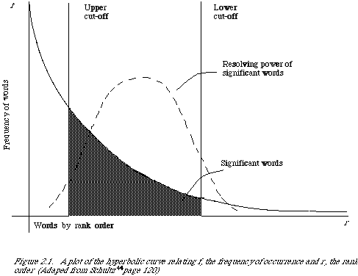
Document frequency
Idea: a term is more discriminative if it occurs only in fewer documents

Slide 25
Recap: retrieval procedure in modern IR
Boolean model provides all the ranking candidates
Locate documents satisfying Boolean condition
E.g., “obama healthcare” -> “obama” OR “healthcare”
Rank candidates by relevance
Important: the notion of relevance
Efficiency consideration
Top-k retrieval (Google)

Slide 26
Recap: vector space model
Represent both document and query by concept vectors
Each concept defines one dimension
K concepts define a high-dimensional space
Element of vector corresponds to concept weight
E.g., d=(x₁,…,x_{k}), x_{i} is “importance” of concept i
Measure relevance
Distance between the query vector and document vector in this concept space

Slide 27
Recap: TF weighting
Idea: a term is more important if it occurs more frequently in a document
TF Formulas
Let $f(t,d)$ be the frequency count of term $t$ in doc $d$
Raw TF: $tf(t,d) = f(t,d)$

Slide 28
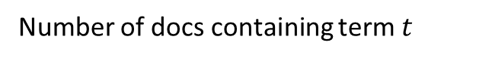
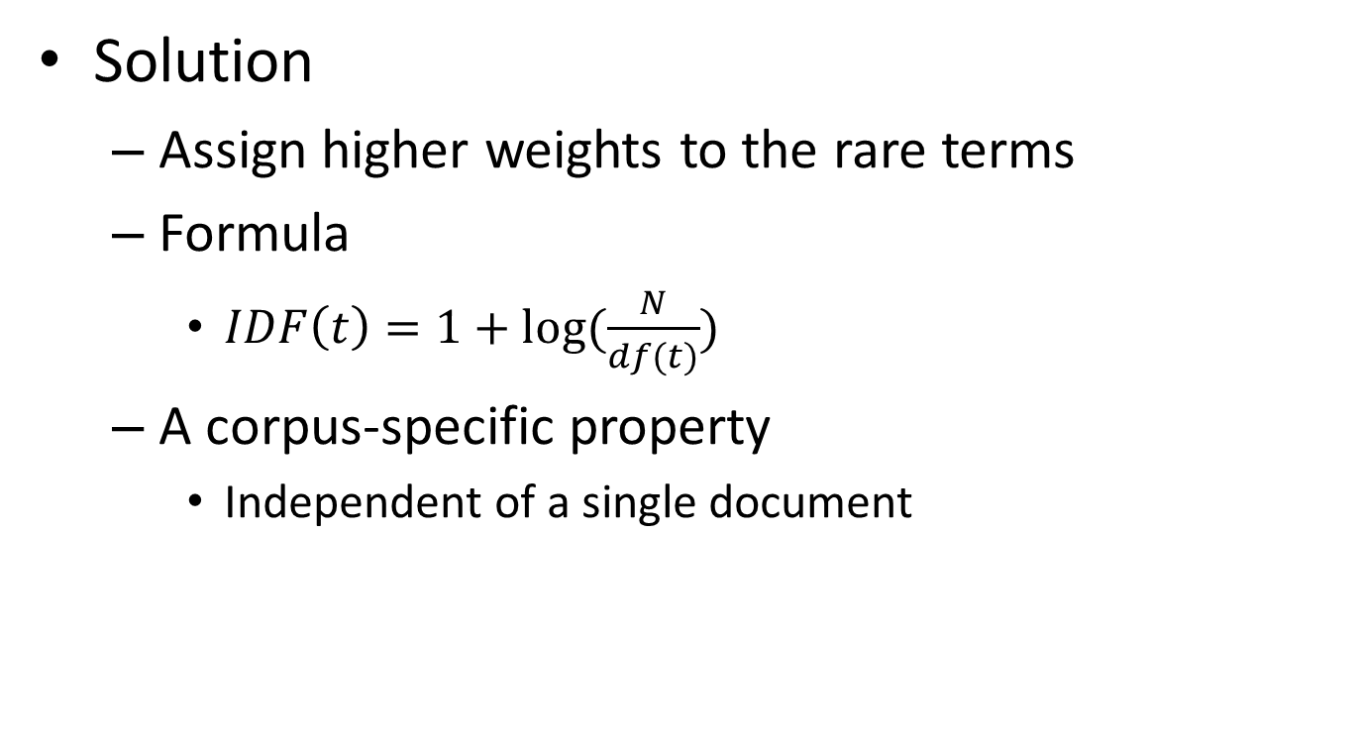
IDF weighting
Solution
Assign higher weights to the rare terms
Formula
$IDF\left(t\right)=1+log⁡(\frac{N}{df(t)})$
A corpus-specific property
Independent of a single document
Non-linear scaling
Total number of docs in collection
Number of docs containing term $t$

Slide 29
Pop-up Quiz
If we remove a document from the corpus, how would it affect a term’s IDF?

Slide 30
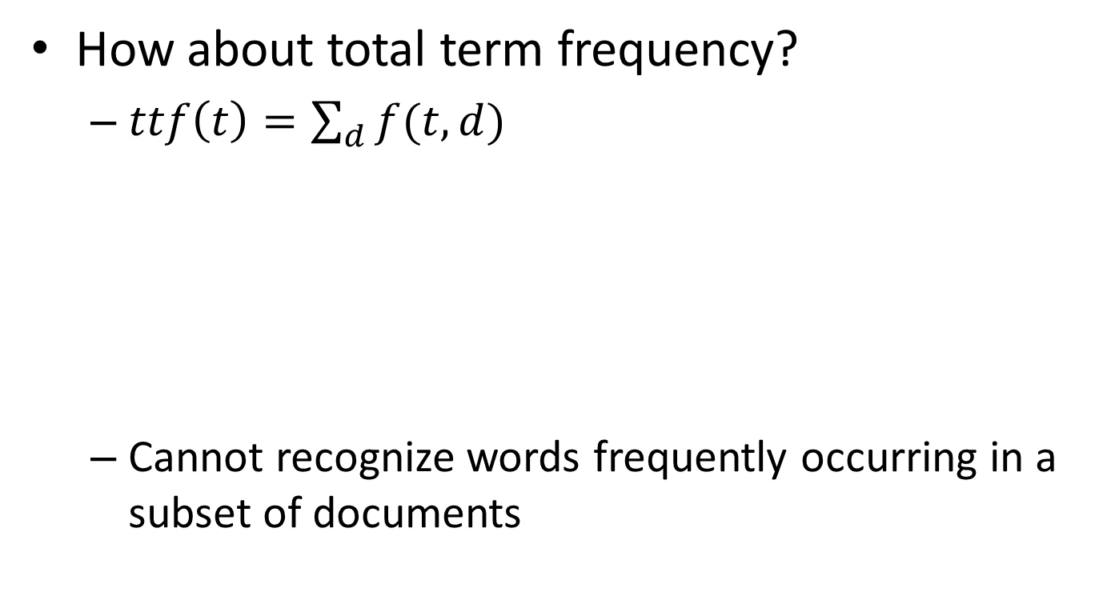
Why document frequency
How about total term frequency?
$ttf\left(t\right)=\sum_{d}{f(t,d)}$
Cannot recognize words frequently occurring in a subset of documents
Table 1. Example total term frequency v.s. document frequency in Reuters-RCV1 collection.
Word | ttf | df
try | 10422 | 8760
insurance | 10440 | 3997

Slide 31
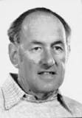
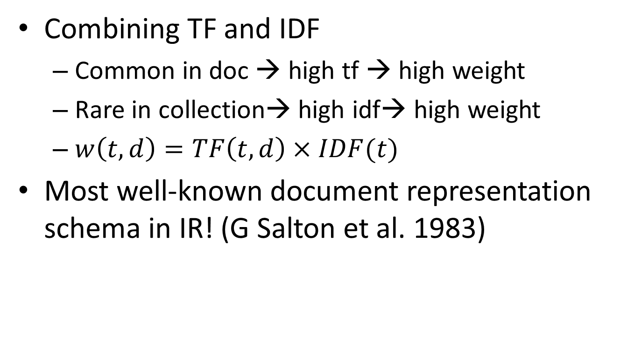
TF-IDF weighting
Combining TF and IDF
Common in doc → high tf → high weight
Rare in collection→ high idf→ high weight
$w\left(t,d\right)=TF\left(t,d\right)×IDF(t)$
Most well-known document representation schema in IR! (G Salton et al. 1983)
“Salton was perhaps the leading computer scientist working in the field of information retrieval during his time.” - wikipedia
Gerard Salton Award
– highest achievement award in IR

Slide 32
How to define a good similarity measure?
Euclidean distance?
Finance
TF-IDF space
D₂
D₄
D₃
Sports
Query
D₅
D₁
Education

Slide 33
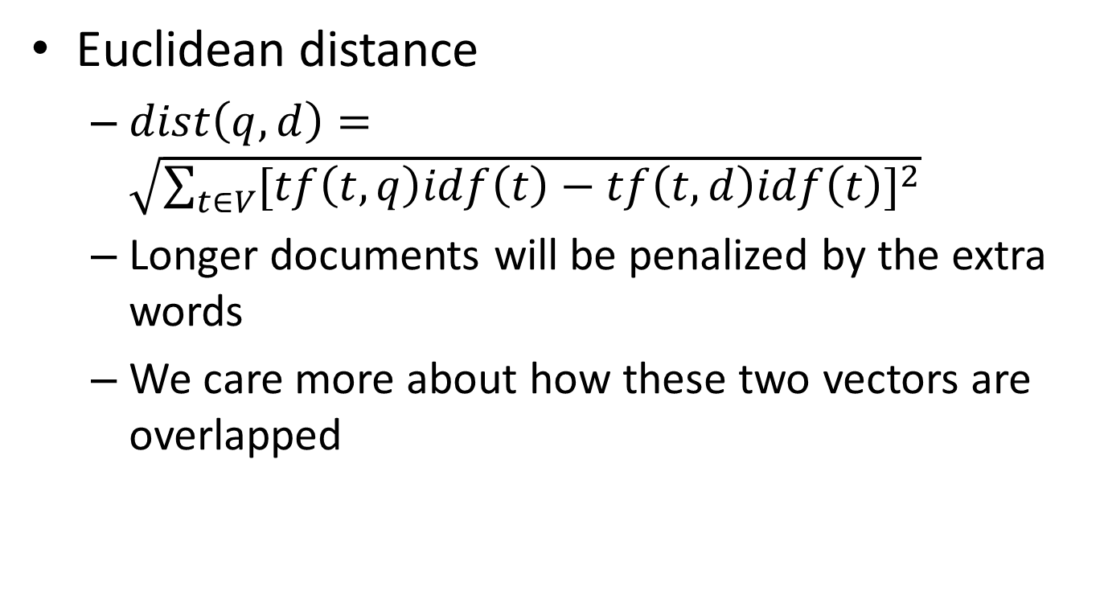
How to define a good similarity measure?
Euclidean distance
$dist\left(q,d\right)=\sqrt{\sum_{t∈V}{{[tf\left(t,q\right)idf\left(t\right)−tf\left(t,d\right)idf\left(t\right)]}^{2}}}$
Longer documents will be penalized by the extra words
We care more about how these two vectors are overlapped

Slide 34
From distance to angle
Angle: how vectors are overlapped
Cosine similarity – projection of one vector onto another
Finance
TF-IDF space
D₁
The choice of angle
The choice of Euclidean distance
D₂
Query
Sports

Slide 35

Cosine similarity
Angle between two vectors
$cosine\left(V_{q},V_{d}\right)=\frac{V_{q}×V_{d}}{{\left|V_{q}\right|}_{2}×{\left|V_{d}\right|}_{2}}=\frac{V_{q}}{{\left|V_{q}\right|}_{2}}×\frac{V_{d}}{{\left|V_{d}\right|}_{2}}$
Document length normalized
TF-IDF vector
Unit vector
Finance
D₂
TF-IDF space
D₁
Query
Sports

Slide 36
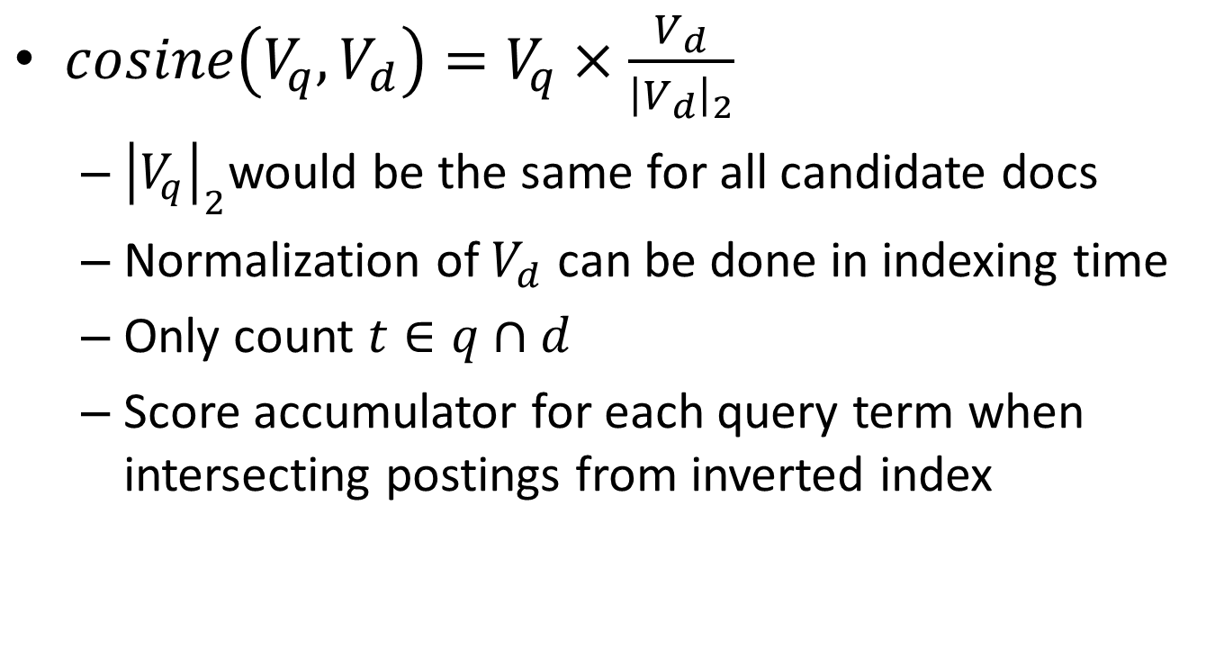
Fast computation of cosine in retrieval
$cosine\left(V_{q},V_{d}\right)=V_{q}×\frac{V_{d}}{{\left|V_{d}\right|}_{2}}$
${\left|V_{q}\right|}_{2}$would be the same for all candidate docs
Normalization of $V_{d}$ can be done in indexing time
Only count $t∈q∩d$
Score accumulator for each query term when intersecting postings from inverted index

Slide 37
Fast computation of cosine in retrieval
Maintain a score accumulator for each doc when scanning the postings
Query = “info security”
S(d,q)=g(t₁)+…+g(t_{n}) [sum of TF of matched terms]
Info: (d1, 3), (d2, 4), (d3, 1), (d4, 5)
Security: (d2, 3), (d4, 1), (d5, 3)
Can be easily applied to TF-IDF weighting!
Accumulators: d1 d2 d3 d4 d5
(d1,3) => 3 0 0 0 0
(d2,4) => 3 4 0 0 0
(d3,1) => 3 4 1 0 0
(d4,5) => 3 4 1 5 0
(d2,3) => 3 7 1 5 0
(d4,1) => 3 7 1 6 0
(d5,3) => 3 7 1 6 3
info
Keep only the most promising accumulators for top K retrieval
security

Slide 38
Advantages of VS Model
Empirically effective! (Top TREC performance)
Intuitive
Easy to implement
Well-studied/Most evaluated
The Smart system
Developed at Cornell: 1960-1999
Still widely used
Warning: Many variants of TF-IDF!

Slide 39
Disadvantages of VS Model
Assume term independence (i.e., BoW)
Assume query and document to be the same
Lack of “predictive adequacy”
Arbitrary term weighting
Arbitrary similarity measure
Lots of parameter tuning!

Slide 40
What you should know
Document ranking v.s. selection
Basic idea of vector space model
Two important heuristics in VS model
TF
IDF
Similarity measure for VS model
Euclidean distance v.s. cosine similarity

Slide 41
Today’s reading
Chapter 1: Boolean retrieval
1.3 Processing Boolean queries
1.4 The extended Boolean model versus ranked retrieval
Chapter 6: Scoring, term weighting and the vector space model
6.2 Term frequency and weighting
6.3 The vector space model for scoring
6.4 Variant tf-idf functions

